Slide 1
AS 1684.2
Residential timber-framed construction
2.6.4 Roof load width (RLW)
and
Timber Roof Framing Plan E
Calculation example

Slide 2
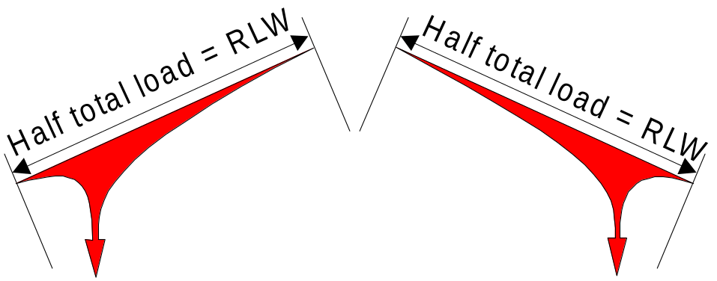
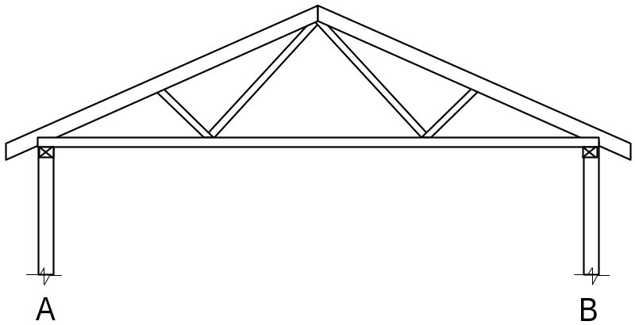
2.6.4 Roof load width (RLW) cont’d.
Of the roof load on members such as rafters and trusses, half will go to the supporting wall or beam on one end and half to the supporting wall or beam on the other end.
Roof load width (RLW) is simply half the particular member’s span, between support point, plus any overhang, and is measured on the rake of the roof.

Slide 3
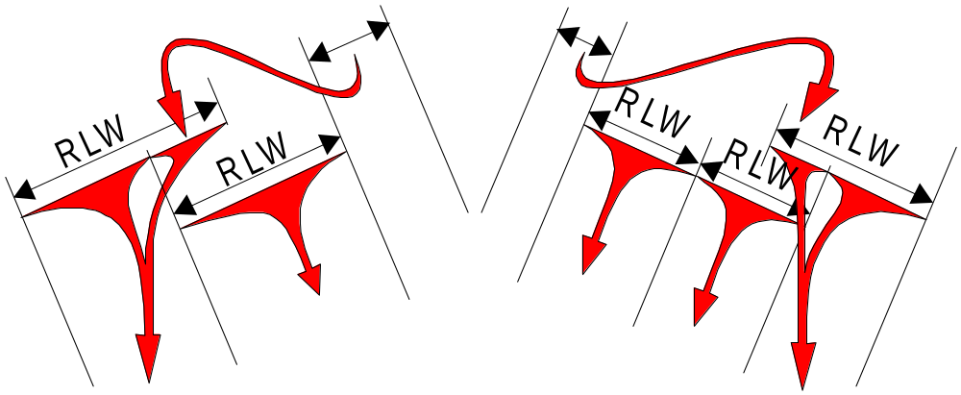
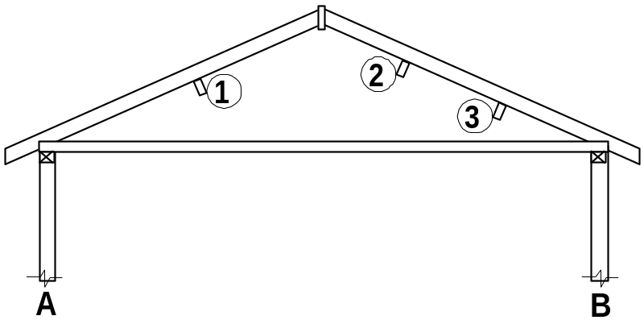
2.6.4 Roof load width (RLW) cont’d.
The same applies to pitched roofs, however the loads are spread between more support points - walls A, B, the underpurlins and ridge struts (if used).
Although RLW's are not shown in AS1684 for the underpurlins, an equivalent measurement to these RLW's will be required to calculate the area supported for the studs that will support the concentrated loads at the end of struts and/or strutting beams that support the underpurlins.

Slide 4
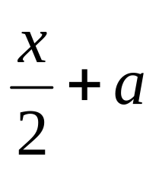
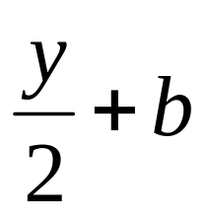
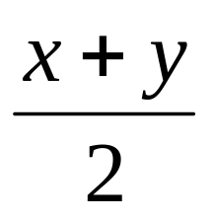
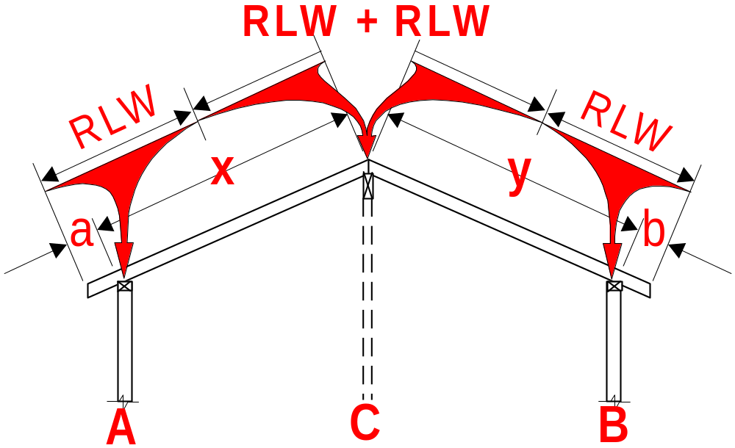
FIGURE 2.13 ROOF LOAD WIDTH (RLW)
(b) Cathedral roof.
RLW wall A =
RLW wall B =
RLW wall C =

Slide 5
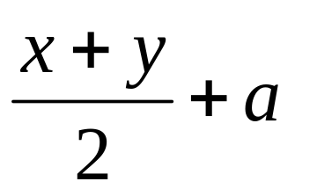
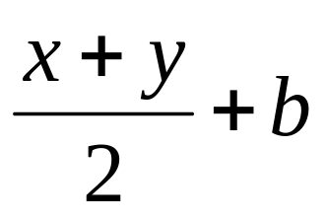
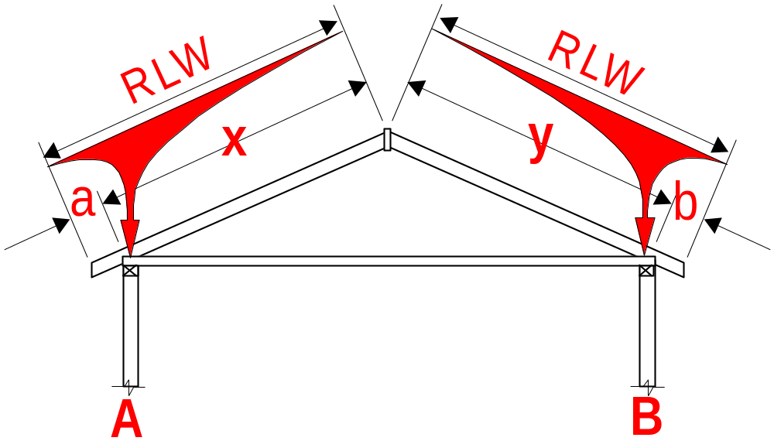
FIGURE 2.14 ROOF LOAD WIDTH (RLW)
COUPLED ROOFS WITH NO UNDERPURLINS
(i) No ridge struts
RLW wall A =
RLW wall A =
7.1.2.2 Coupled Roof
For this roof structure the maximum distance between external walls shall not exceed 6 (six) metres for sheet roofs and 4 (four) metres for tile roofs.

Slide 6
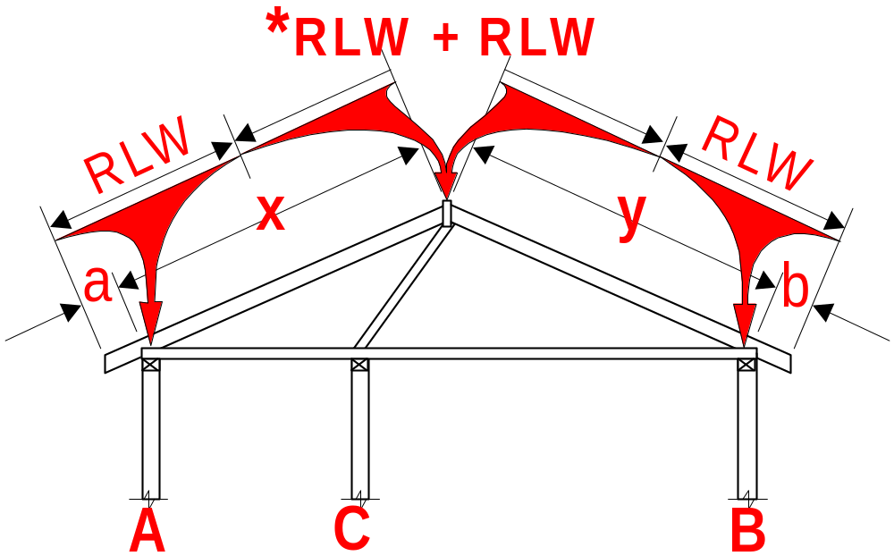
FIGURE 2.14 ROOF LOAD WIDTH (RLW)
COUPLED ROOFS WITH NO UNDERPURLINS
(ii) With ridge struts
RLW wall A =
RLW wall B =
*RLW wall C =
*Although it states that a RLW is not applicable (N/A) for wall 'C,' a measurement equal to the 'RLW' shown at right and calculated above, will be required to calculate the area supported by the 'studs supporting concentrated loads' in wall 'C'.

Slide 7
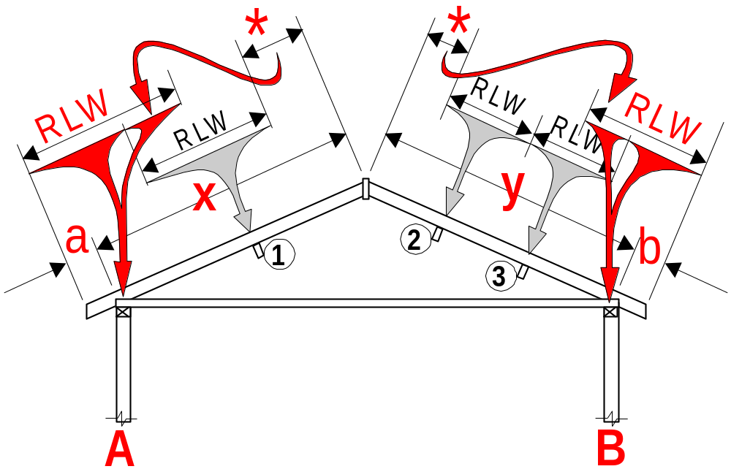
FIGURE 2.15 ROOF LOAD WIDTH (RLW)
COUPLED ROOFS WITH UNDERPURLINS
(i) No ridge struts
RLW wall A =
RLW wall B =
*
For a pitched roof without ridge struts, it is assumed that some of the load from the un-supported ridge will travel down the rafer to walls 'A' and 'B'. The RLW's for walls A & B are increased accordingly.

Slide 8

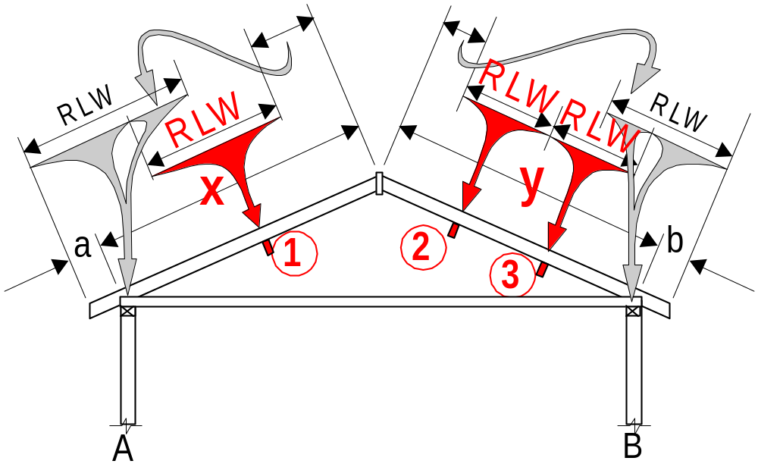

FIGURE 2.15 ROOF LOAD WIDTH (RLW)
COUPLED ROOFS WITH UNDERPURLINS
(i) No ridge struts
Although RLW's are not shown for the underpurlins these RLW's are required by the Underpurlin span table and to calculate the area supported by the ‘studs supporting concentrated loads’ at the end of struts and/or strutting beams that support the underpurlins.
Underpurlin 1 =
Underpurlin 2 =
Underpurlin 3 =

Slide 9
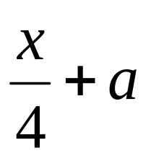
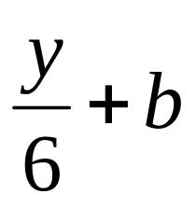
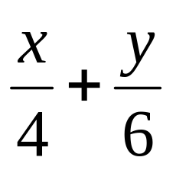
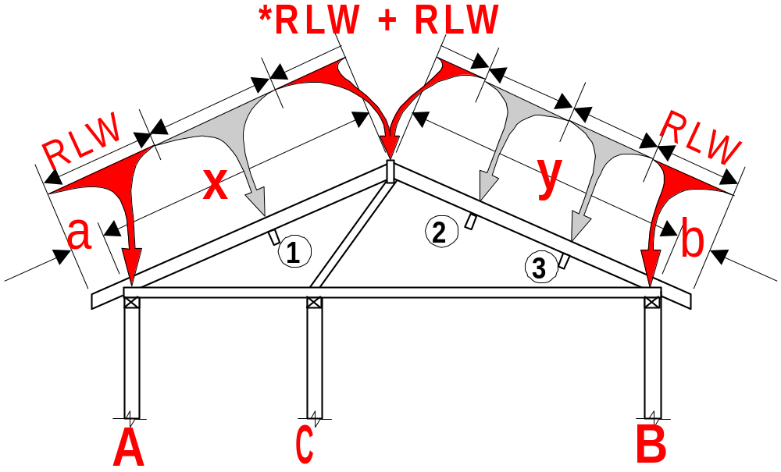
FIGURE 2.15 ROOF LOAD WIDTH (RLW)
COUPLED ROOFS WITH UNDERPURLINS
(ii) With ridge struts
RLW wall A =
RLW wall B =
*RLW wall C =
*
Although it states that a RLW is not applicable (N/A) for wall 'C,' a measurement equal to the 'RLW' shown at right and calculated above, will be required to calculate the area supported by the 'studs supporting concentrated loads' in wall 'C'.

Slide 10
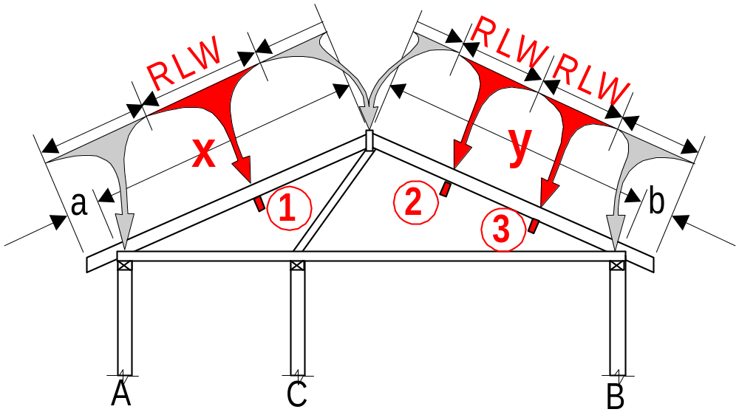
FIGURE 2.15 ROOF LOAD WIDTH (RLW)
COUPLED ROOFS WITH UNDERPURLINS
(i) With ridge struts
Although RLW's are not shown for the underpurlins these RLW's are required by the Underpurlin span table and to calculate the area supported by the ‘studs supporting concentrated loads’ at the end of struts and/or strutting beams that support the underpurlins.
Underpurlin 1 =
Underpurlin 2 =
Underpurlin 3 =

Slide 11
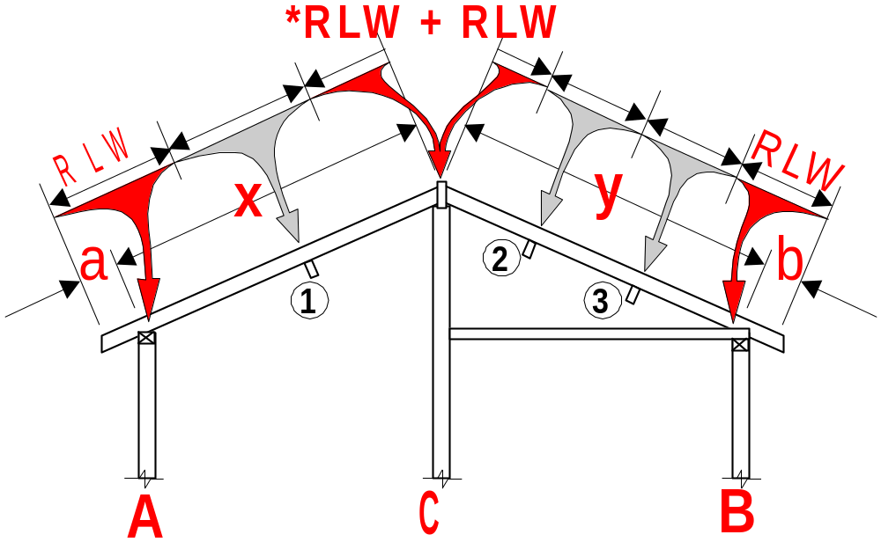
FIGURE 2.16 ROOF LOAD WIDTH (RLW)
COMBINATIONS AND ADDITIONS
(i) Cathedral - Framed (pitched)
RLW wall A =
RLW wall B =
RLW wall C =

Slide 12
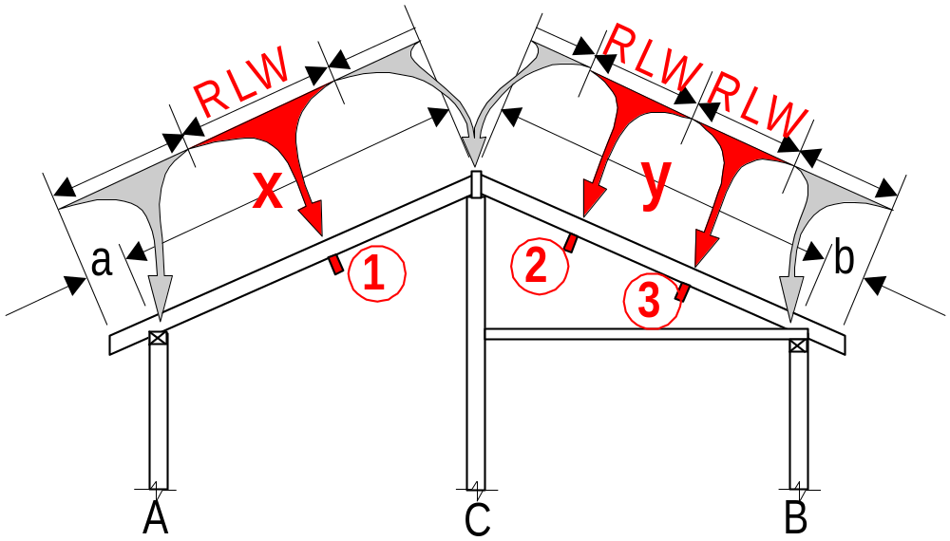

FIGURE 2.16 ROOF LOAD WIDTH (RLW)
COMBINATIONS AND ADDITIONS
(i) Cathedral - Framed (pitched)
Although RLW's are not shown for the underpurlins these RLW's are required by the Intermediate Beam and Underpurlin span tables and to calculate the area supported by the ‘studs supporting concentrated loads’ at the end of struts and/or strutting beams that support the underpurlins.
Beam 1 =
Underpurlin 2 =
Underpurlin 3 =

Slide 13
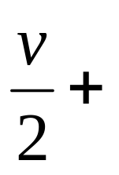
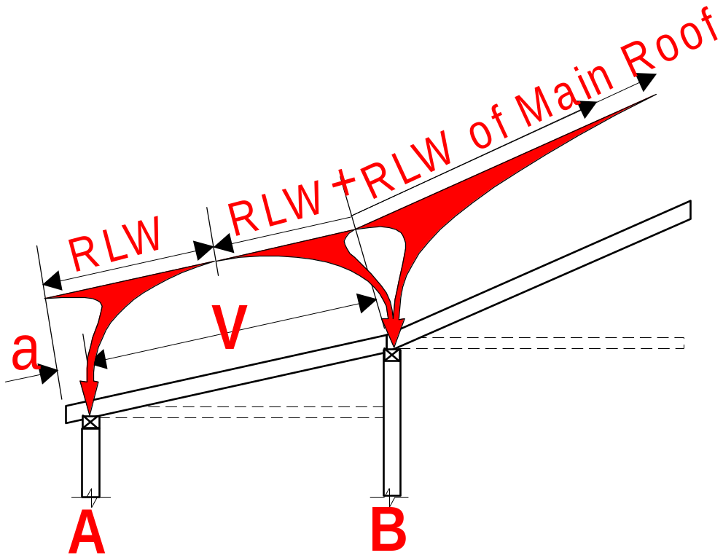
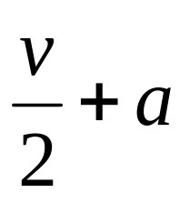
FIGURE 2.16 ROOF LOAD WIDTH (RLW)
COMBINATIONS AND ADDITIONS
(iii) Verandah
RLW wall B =
RLW of Main Roof
RLW wall A =

Slide 14
2.6.5 Area supported
The area supported by a member is the contributory area, measured in either the roof or floor plane that imparts load onto supporting members.
The area supported by a member is calculated by multiplying together a combination of load widths, spans or spacings.

Slide 15
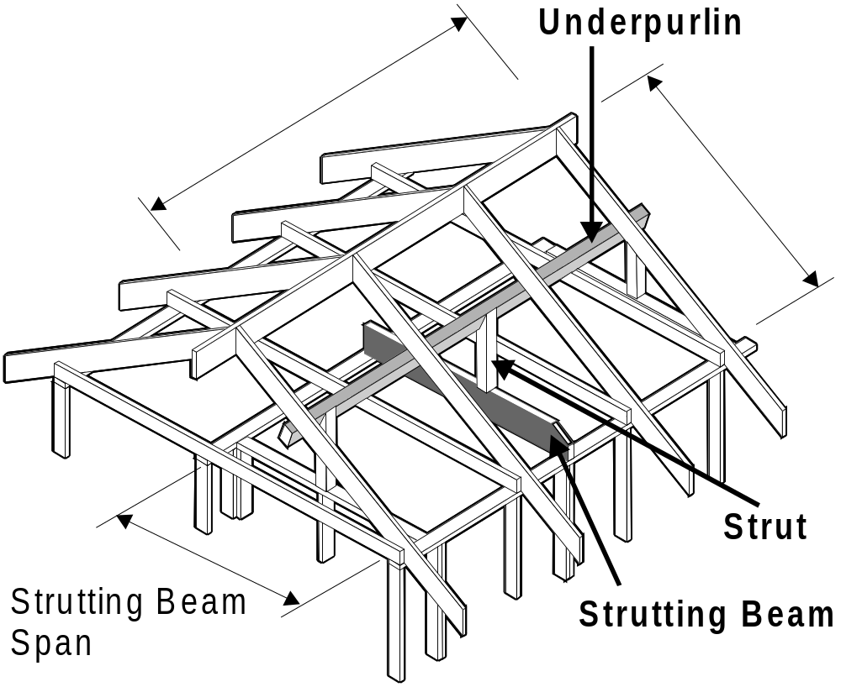
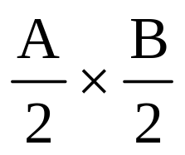
2.6.5 Area supported - FIGURE 2.17 (a)
EXAMPLE: The STRUTTING BEAM span table (Table 27) requires a ‘Roof Area Supported (m²)’ input.
The strutting beam shown supports a single strut that supports an underpurlin.
The area required is the roof area supported by the strut. This is calculated as follows:-
A
A/2
B
B/2
The sum of, half the underpurlin spans either side of the strut (A/2),
multiplied by the sum of half the rafter spans either side of the underpurlin (B/2).
Roof Area Supported =

Slide 16
2.6.5 Area supported - FIGURE 2.17 (a)
NOTE:
B/2 (the sum of half the rafter spans either side of the underpurlin) is the ‘RLW’ for the underpurlin.
B
B/2

Slide 17
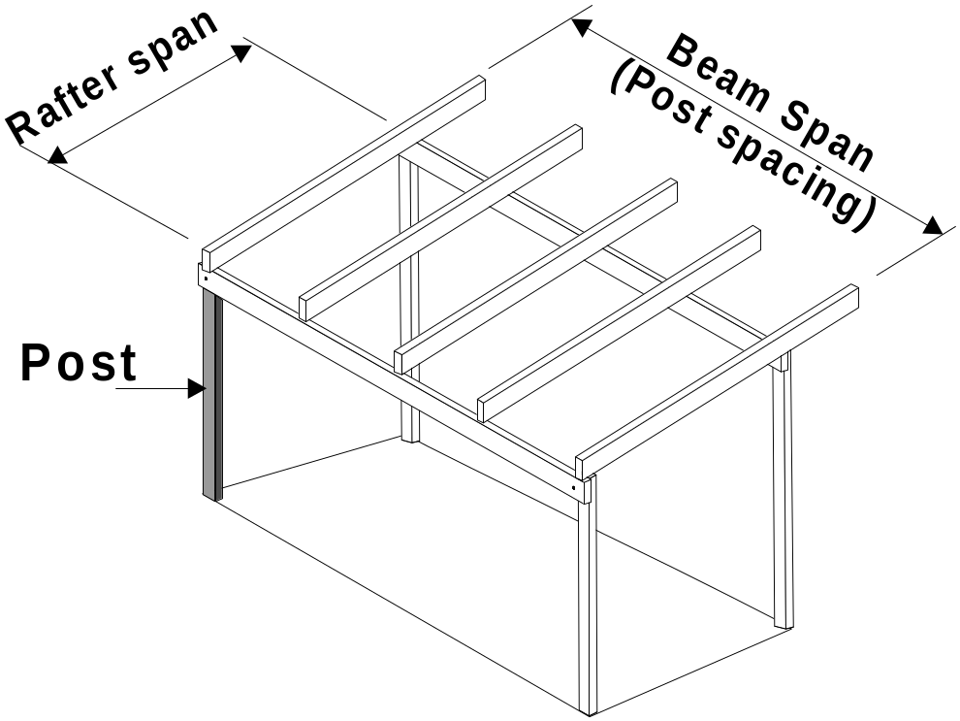
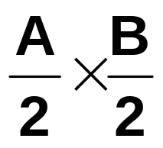
2.6.5 Area supported - FIGURE 2.17 (b)
EXAMPLE: The POSTS SUPPORTING ROOF AND/OR FLOOR LOADS span table (Table 53) requires a ‘Floor Load Area (m²) and a ‘Roof Load Area (m²)’ input.
The Post shown supports a roof load only so only a ‘Roof Load Area’ needs to be calculated.
The roof area required is calculated as follows:-
A
B
B/2
The half the Rafter span (A/2) plus any overhang,
A/2
multiplied by half the Beam Span (Post spacing) (B/2).
Roof Load Area =

Slide 18
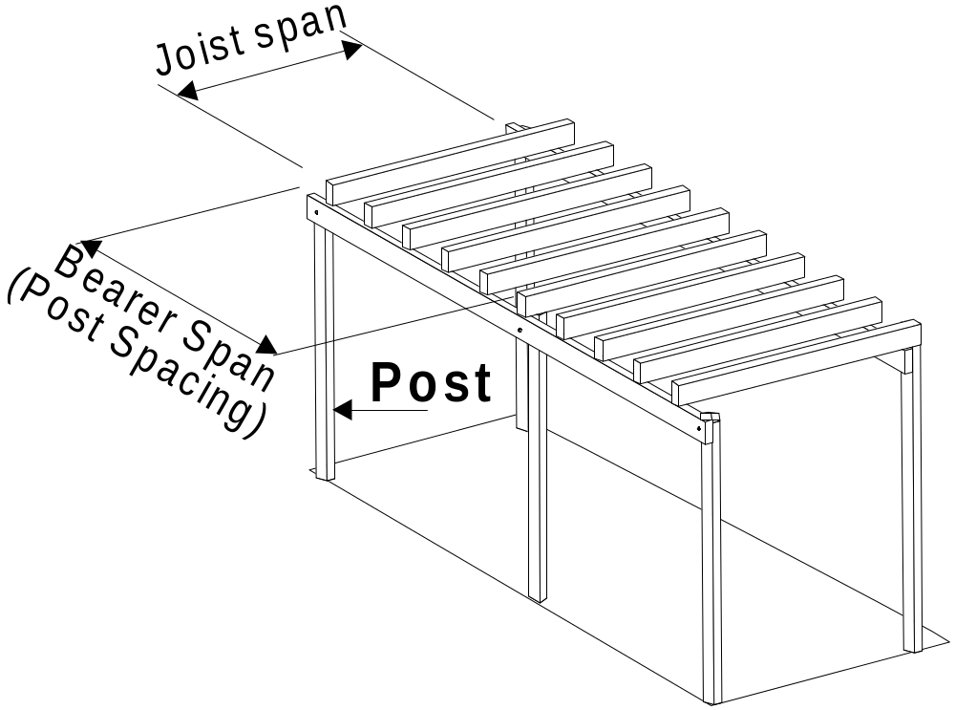
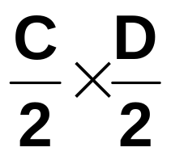
2.6.5 Area supported - FIGURE 2.17 (b)
EXAMPLE: The POSTS SUPPORTING ROOF AND/OR FLOOR LOADS span table (Table 53) requires a ‘Floor Load Area (m²) and a ‘Roof Load Area (m²)’ input.
The Post shown supports a floor load only.
The Floor area required is calculated as follows:-
C
C/2
The half the Floor joist span (C/2) plus any cantilever,
multiplied by half the Bearer Span (Post spacing) (B/2).
D/2
D
Floor Load Area =

Slide 19
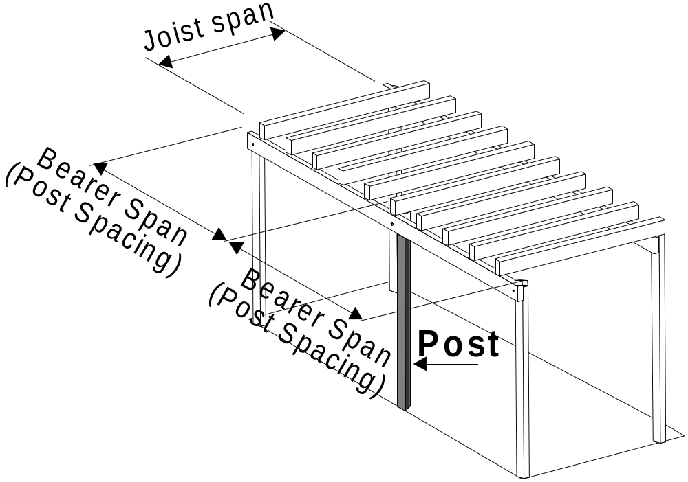
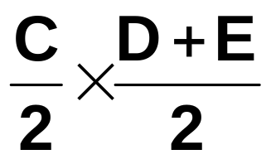
2.6.5 Area supported - FIGURE 2.17 (b)
This Post supports floor loads on either side.
The Floor area required is calculated as follows:-
C
C/2
The half the Floor joist span (C/2) plus any cantilever,
multiplied by half the Bearer Span (Post spacing) on either side of the post
D
D+E .. 2
(
)
D+E .. 2
E
Floor Load Area =

Slide 20
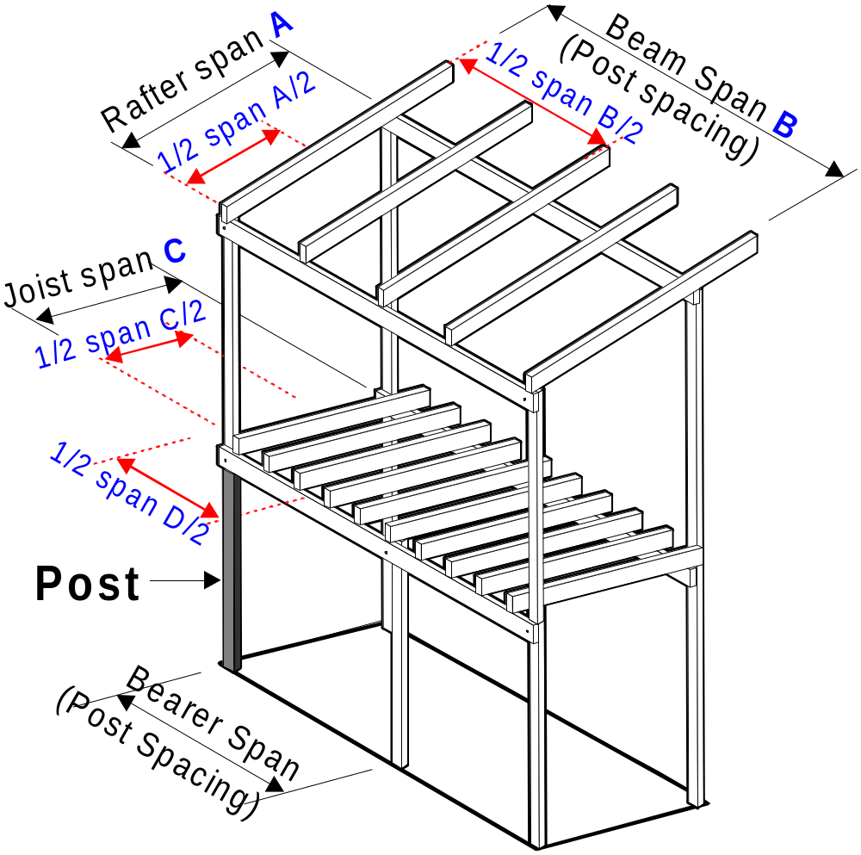
2.6.5 Area supported - FIGURE 2.17 (b)
As this Post supports both roof and floor loads, the ‘Roof Load Area’ and the ‘Floor Load Area’ are required as inputs to Table 53 and are calculated individually as per the previous examples.
END OF SECTION 2

Slide 21
Timber Roof Framing
Using the timber-framed construction (AS 1684.2-1999) and Supplement Member Tables determine for Plan E:
a) Span and spacing of structural members
and
b) Mark on Plan the Roof Frame Overlay
c) Mark on Plan the Roof Strutting Overlay

Slide 22
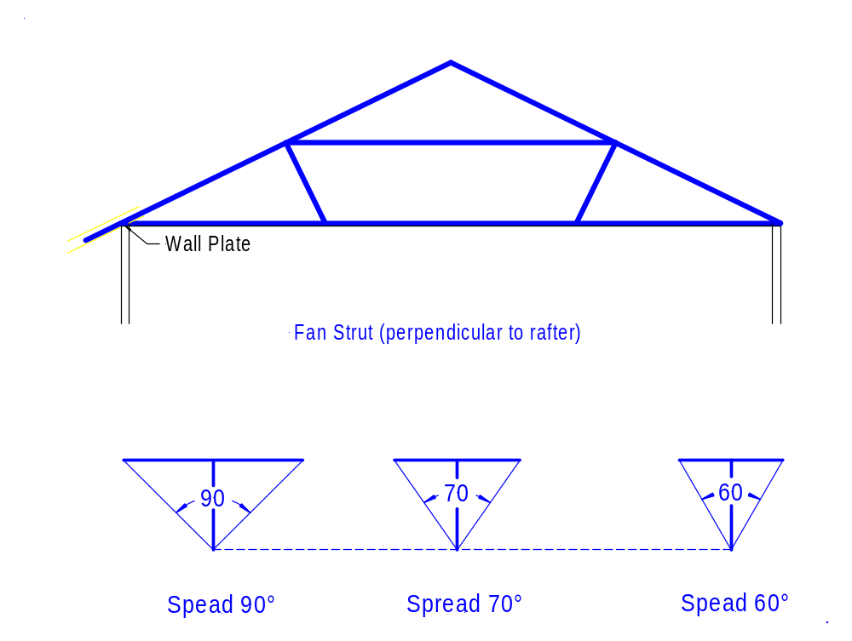
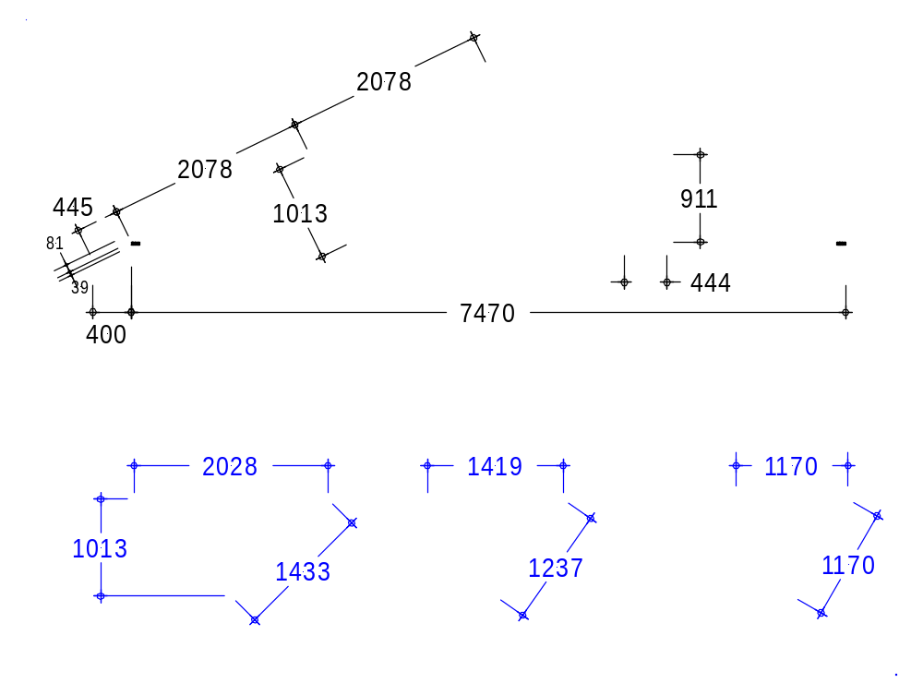
Calculations for Roof Members (Plan E)
1) Rafter run = external width between the wall plates divided by two
2) Rafter span = rafter run divided by cos 26°
3) Overhang = eaves width divided by cos 26°
4) Ridge strut = rafter run times tan26°
5) Decide whether an underpurlin is needed; if it is place it at mid-span
6) New rafter span = rafter span found in 2) divided by two
7) Strut perpendicular to rafter = rafter span time tan 26°
All calculations figures shown opposite
7.2.15 Roof strutting
Roof struts provide support for:
Underpurlins
Ridge boards
Hip rafters and
Valley rafters
Figure 1

Slide 23
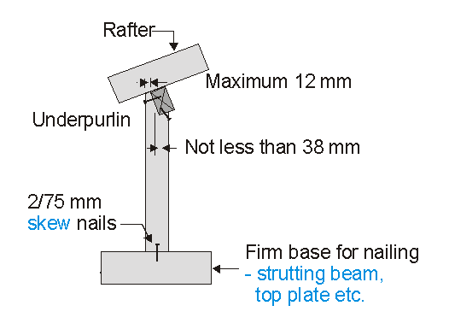
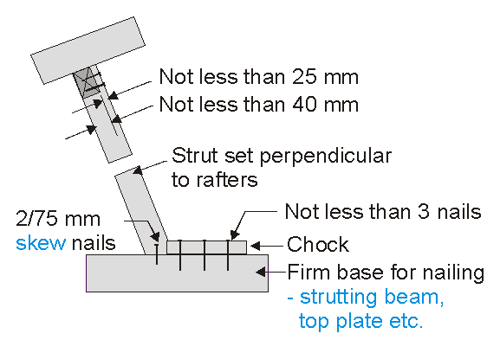
7.2.15 Roof strutting
If possible use vertical struts.
However struts can be either vertical a) or
perpendicular b) to the rafter.
Struts must be birthmouthed if not vertical they must be restrained by blocks or chocks (see b)).
Fan struts can be used to reduce the span of underpurlins. Two opposing struts must be used in the same plane.
a)
b)

Slide 24
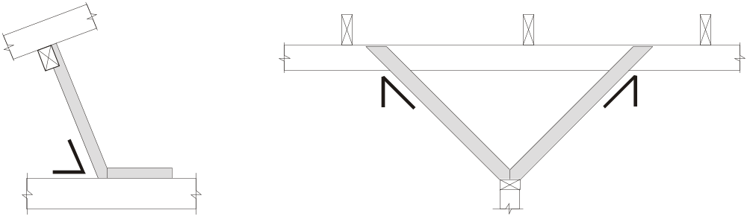
7.2.15.3 Fan struts
60^{O} max.
45^{O} max.
45^{O} max.
EQUAL
that means Roof pitch 30° or less
that means max. spread

Slide 25
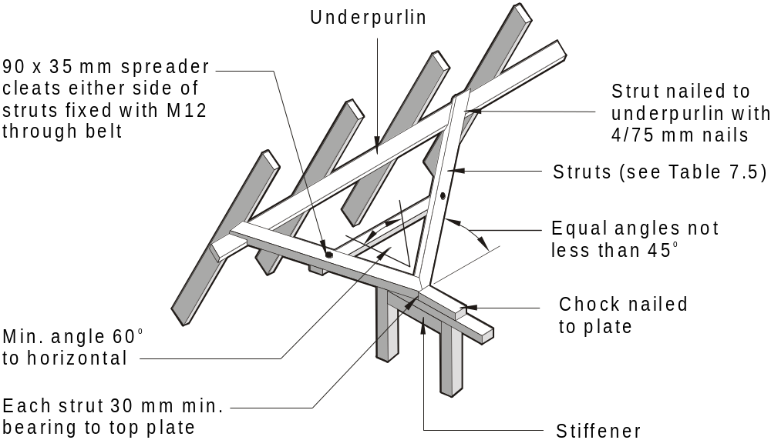
FIGURE 7.12 FAN OR FLYING STRUTS

Slide 26
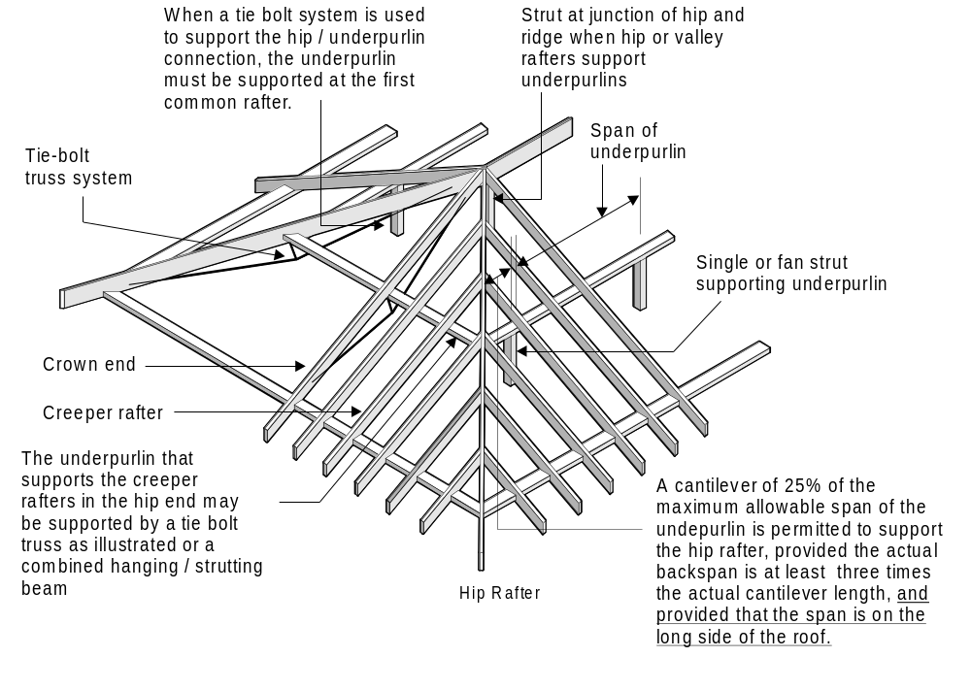
7.2.17 HIP ENDS
FIGURE 7.14 HIP END

Slide 27
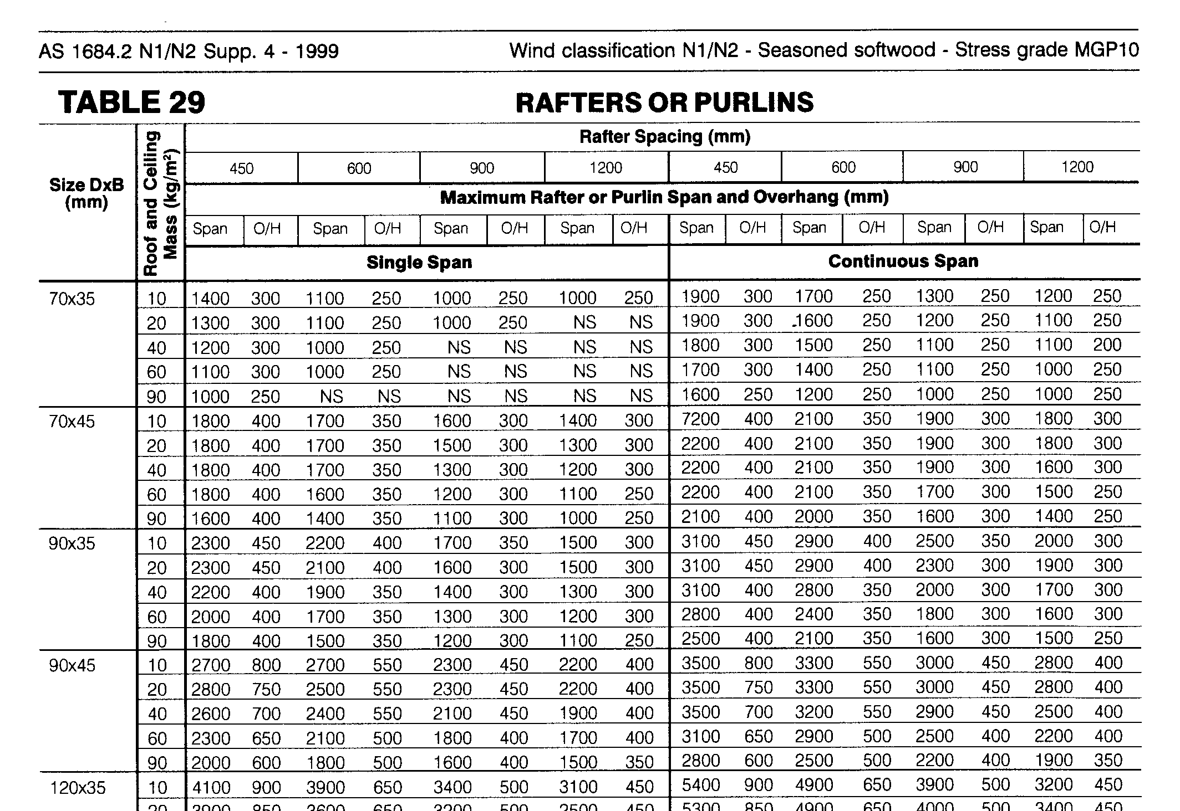
Rafter Span Table (MGP 10)

Slide 28
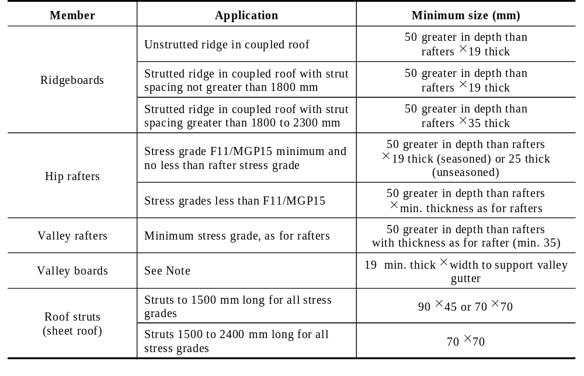
TABLE 7.6
OTHER MEMBERS AND COMPONENTS
Depth not less than length of the rafter plumb-cut x 19 thick
Depth not less than length of the rafter plumb-cut x 19 thick

Slide 29
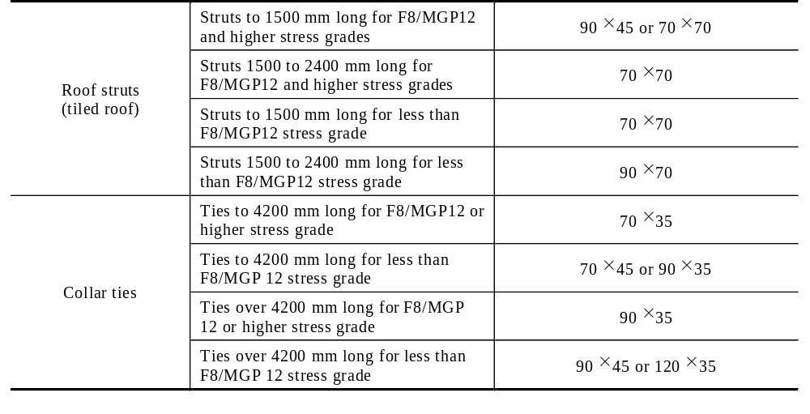
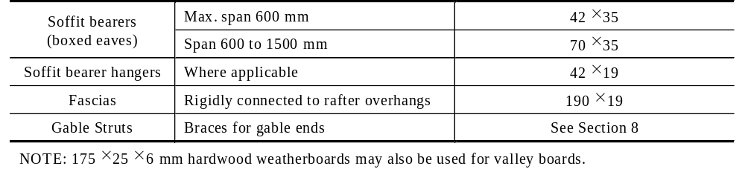
TABLE 7.6 OTHER MEMBERS AND COMPONENTS continued

Slide 30

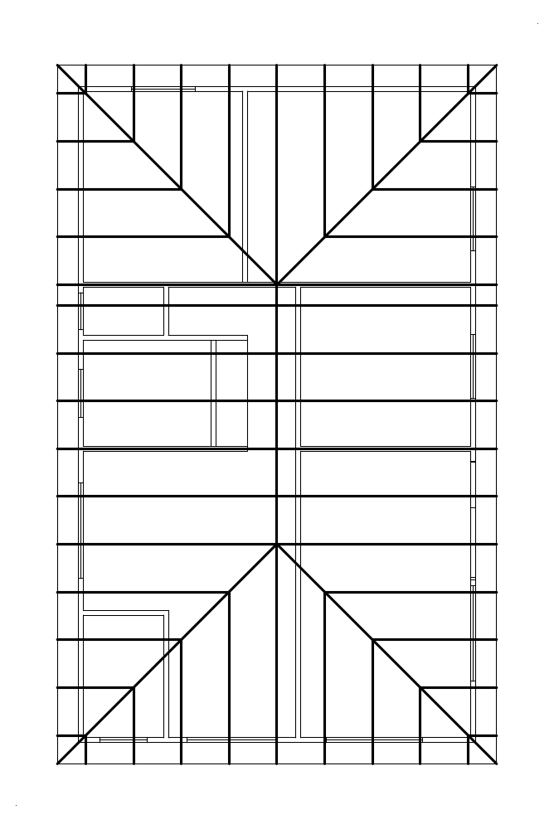

Roof
Frame
Overlay
Rafter Overlay
Underpurlins (7.2.10)
Clearly mark the position of rafters, creepers, collar ties and underpurlins
Collar ties (7.2.17)

Slide 31
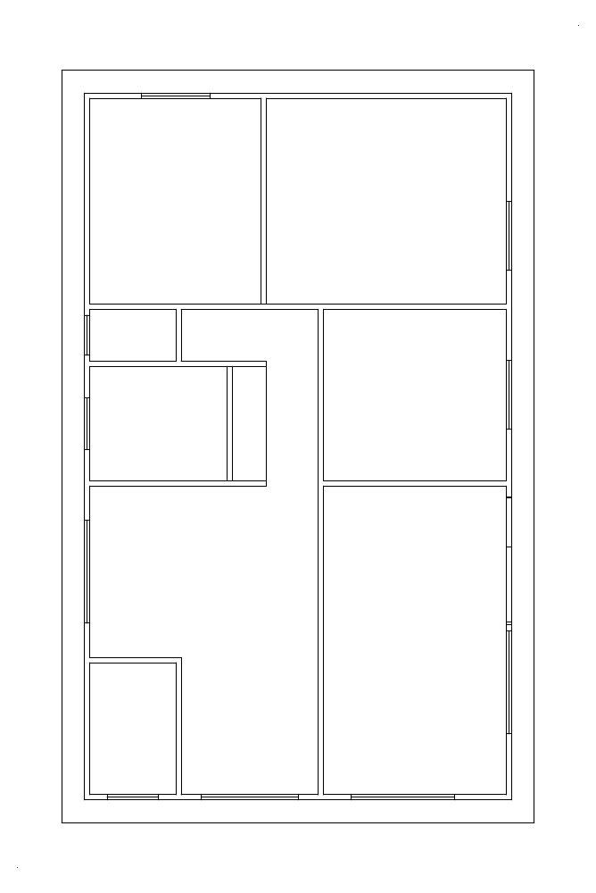
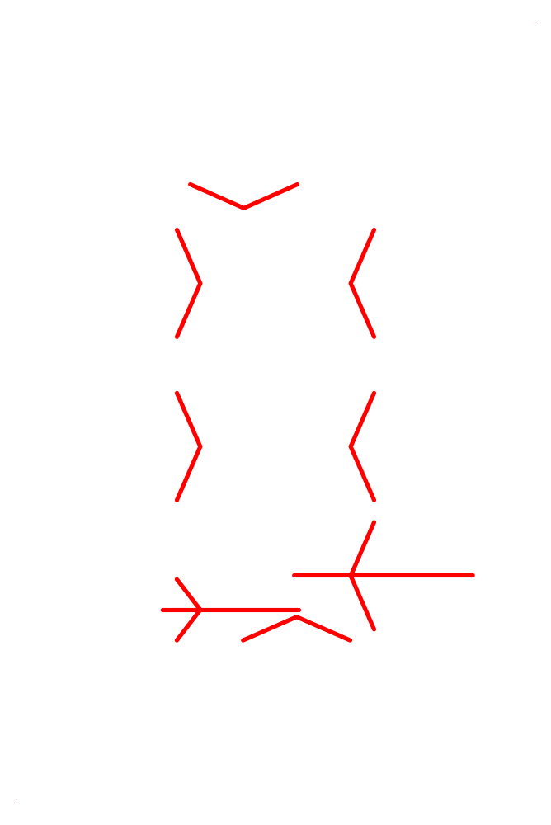
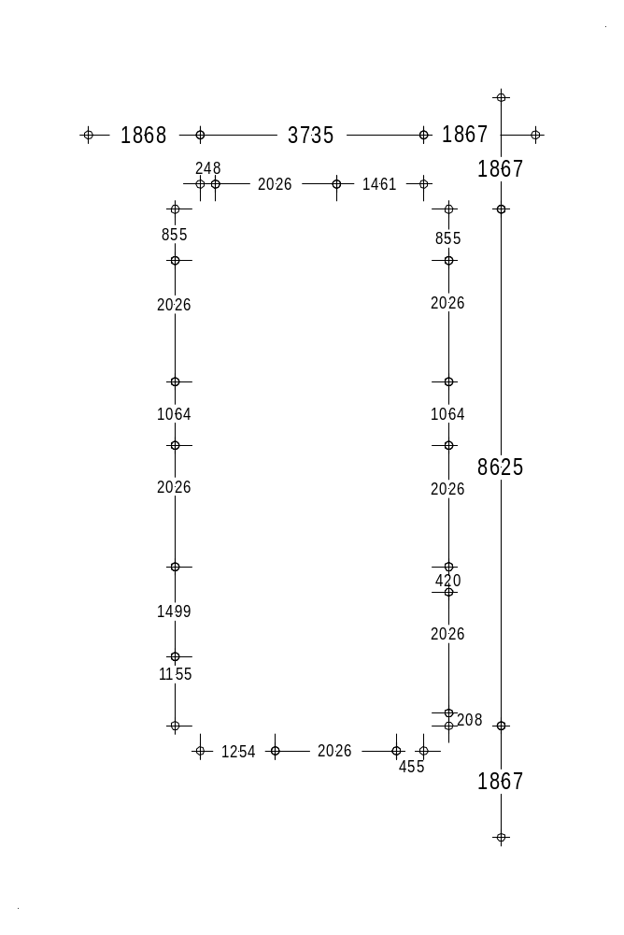
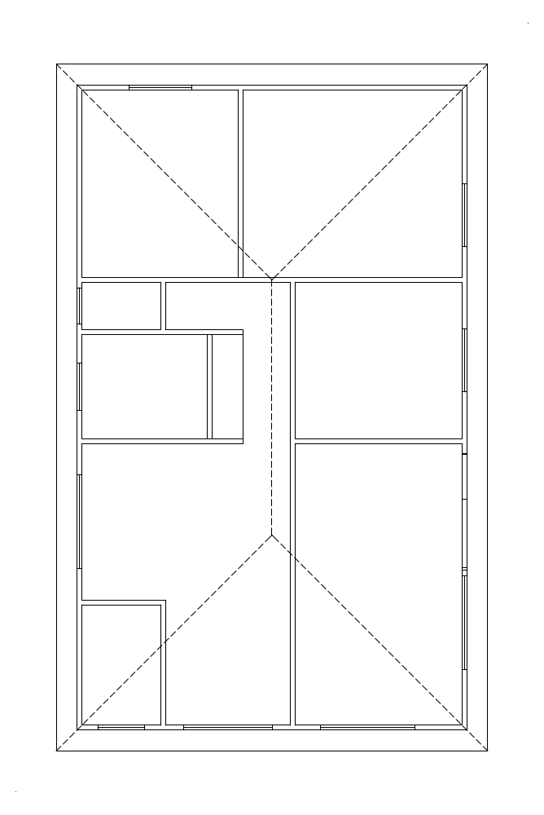
Roof
Strutting
Overlay
Underpurlins (7.2.10)
Fan struts (7.2.15.3) & strutting beams (7.2.9)
Clearly mark the position of underpurlins, beams, roof struts, and other supports.
Span of the underpurlins between Struts/supports

Slide 32
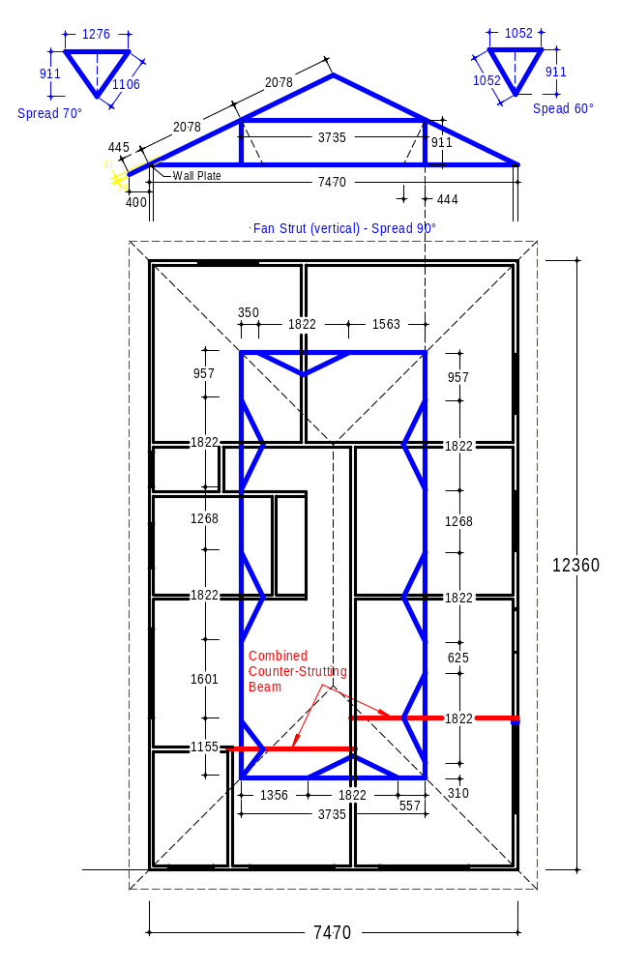

Exercise Plan E
Vertical Struts
Struts perpendicular to rafter

Slide 33










= the span of rafter 2078 mm
1152+(1499/2)
= 1905
208+2026+(420/2)
= 2444
Position of strutting beam
Position of strutting beam
1) Determine Roof Load Width (RLW)
2) Determine Position of underpurlins
3) Calculate the roof area supported (RAS)

